Slide 1
PRICINPLE DATABASE MANAGEMENT PROJECT
EMPLOYEE MANAGEMENT SYSTEM
Lecturer: Dr. Nguyen Thi Thuy Loan
Group’s members:
Truong Thai Ngoc Toan ( Leader)
Ly Minh Trung
Mai Dang Nhat Anh
Phan Hung Thinh

Slide 2
Table of Contents
Overview
01
About the topic and Objective
ERD – Relational Model
02
Analyze the topic, ER Diagram, Relational Model
Database
03
Database building by SQL
Java Application – Final Result
04
Creating Application and Connect to Database

Slide 3
Overview
Introduction
One of the most necessary things which companies care about is how to manage their employees effectively. Have you ever heard of a company that does not have a clear HR (Human Resources) management system affecting its financial income and leading to a loss of company revenue? The core of a company is its human resources. So it is not too difficult to understand when any company needs to have an HR management system.
Objective
Help users to view all personal information, work progress, salary, or edit data as well as manage employee by admin.

Slide 4
Analyzing the Topic
Admin/Manager
View infor
Add/Remove
Update
Payroll
System
Employee
View Infor
View Attend
View Salary

Slide 5

Admin
Company will provide account to them for keep track other employeeswith several functions below:
Add a new employee after recruitment, remove employee if they don’t go to work anymore.
Calculate employee’s salary base on their attendance and their salary amount.
Finding who has the best performance on month to give them a bonus.
Admin can see a list of employees whose are managing.
Get feedback from employees to improve the company.

Slide 6

Employee
Company also provide the account to employee for seeing their:
Information ( ID, name, gender, date of birth, address, contact, department, salary)
Salary
Attendance
Suggest the idea to manager for improve the company.

Slide 7
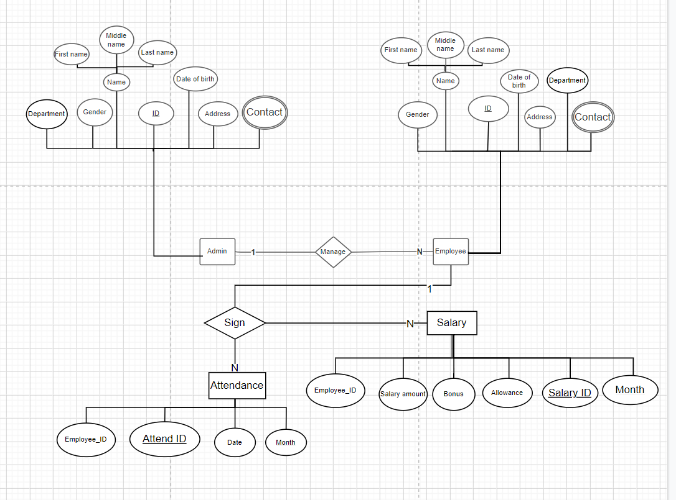
ER Diagram

Slide 8
Relational Model
Admin
Employee
Interaction
Admin.Contact
AD_ID | Department | Gender | First name | Middle name | Last name | Date of birth | Address
EM_ID | AD_ID | Department | Gender | First name | Middle name | Last name | Date of birth | Address
AD_ID | EM_ID | Voice Grievances
AD_ID | Email | Phone

Slide 9
Relational Model
Employee.Contact
Salary
Attendance
Login
EM_ID | Email | Phone
Salary_ID | Salary amount | Bonus | Allowance | Month
Attend_ID | Absences | Date | Month
Username | Password | Postion

Slide 10
Database
SQL Query

Slide 11
Java Application - Result

Slide 12
THANK YOU

